Slide 1
Sql for Data analysis

Slide 2
MySql
Role of sql in data science
A major part of a Data Scientist’s role involves handling data from a variety of Data Sources. This includes:
Extracting the data out of production schemas
Querying databases and concatenating datasets together.
Cleaning and formatting data
Storing data into a suitable physical location so you can run your analysis.

Slide 3
Database introduction
What is a Database?
A database is a collection of related data which represents some aspect of the real world. A database system is designed to be built and populated with data for a certain task.
What is DBMS?
Database Management System (also known as DBMS) is a software for storing and retrieving users' data by considering appropriate security measures. It allows users to create their own databases as per their requirement.
- A group of programs which manipulate the database
- Provides an interface between the database and end user.
- Includes details about the users of the database and other application programs.
- Accepts requests for data from an application and retrieves the specific data.
- Allows third-party software to store and retrieve data.

Slide 5
Hierarchical dbms
Types of dbms

Slide 6
Network dbms
Types of dbms

Slide 7
Object oriented dbms
Types of dbms

Slide 8
RDBMS
What is RDBMS?
- Stands for "Relational Database Management System."
- An RDBMS is a subset of DBMS designed specifically for relational databases.
- Stores data in a structured format, using rows and columns.
- It is "relational" because the values within each table are related to each other.
- Tables may also be related to other tables.
- The relational structure makes it possible to run queries across multiple tables.

Slide 9
Popular RDBMS Software
MySQL
Microsoft Access
Oracle
PostgreSQL
dBASE
FoxPro
SQLite
IBM DB2
LibreOffice Base
MariaDB
Microsoft SQL Server etc.

Slide 10
RDBMS Concepts

Slide 11
What is a table
MySql
In a Relational database model, a table is the most simplest form of data storage
It is a collection of data elements organised in terms of rows and columns.
A table is also considered as a convenient representation of relations.

Slide 12
What is tuple
Mysql
A single entry in a table is called a Tuple or Record or Row.
A tuple in a table represents a set of related data. For example, the Agents table has 5 tuples/records/rows.

Slide 13
What is an attribute
Text
A table consists of several records(row)
Each record can be broken down into several smaller parts of data known as Attributes.
The Agents table consists of five attributes, agent_code, agent_name, working_area, commission and phone_no

Slide 14
No-sql Databases

Slide 15
What is no-sql
Text
NoSQL, or most commonly known as ‘Not only SQL’ database,
It provides a mechanism for storage and retrieval of unstructured data.
It can handle a humongous amount of data and has a dynamic schema.
A NoSQL database has no specific query language and no or a very few relationships.

Slide 16
No Sql Databases
KEY-VALUE STORES The simplest NoSQL databases. Each item in the database is stored as an attribute name (or "key") together with its value. Examples include Riak, Voldemort, and Redis.
WIDE COLUMN STORES Store columns of data together instead of rows They are optimized for queries over large datasets. Cassandra and HBase are wide-column databases.
DOCUMENT DATABASES
Store data as key-value pairs Each key is paired with a complex data structure known as a document. Documents can contain many different key-value pairs or even nested documents. MongoDB is a document database.
GRAPH DATABASES
Used to store information about networks, such as social connections. Examples include Neo4J and HyperGraphDB.

Slide 17
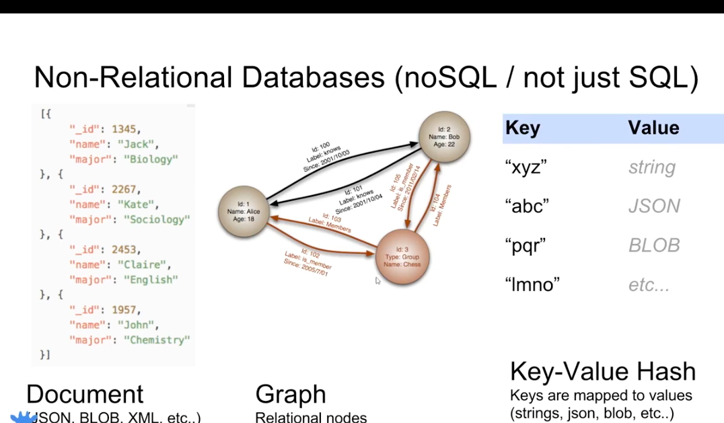

Slide 18
Wide column store
Text

Slide 19
A comparison
Text
Sql | NoSql
Relational database | Non-relational database
Predefined schema | Dynamic Schema
Table based databases | Key-value pair, documents, graph based etc.
Better fit for complex query environment | Not a good fit for complex queries
Vertically scalable. | Horizontally scalable.
Heavy-duty transactions | Not stable in high load and complex transactions
MySql, Oracle, PostGreSql | MongoDb, Cassandra, HBase

Slide 20
mysql and workbench
Installation

